Slide 2
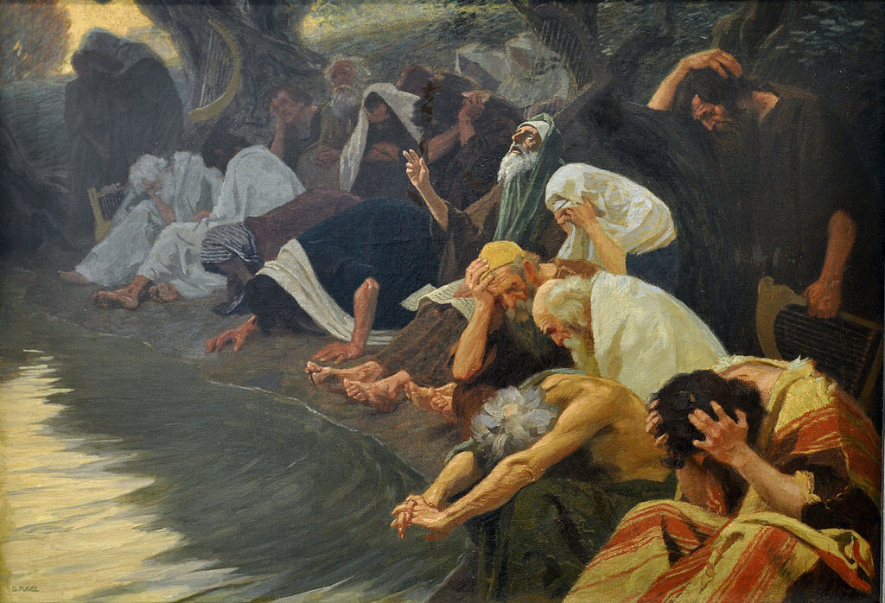

Slide 3
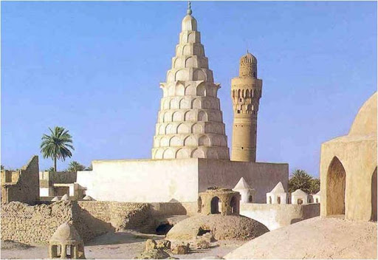

Slide 4
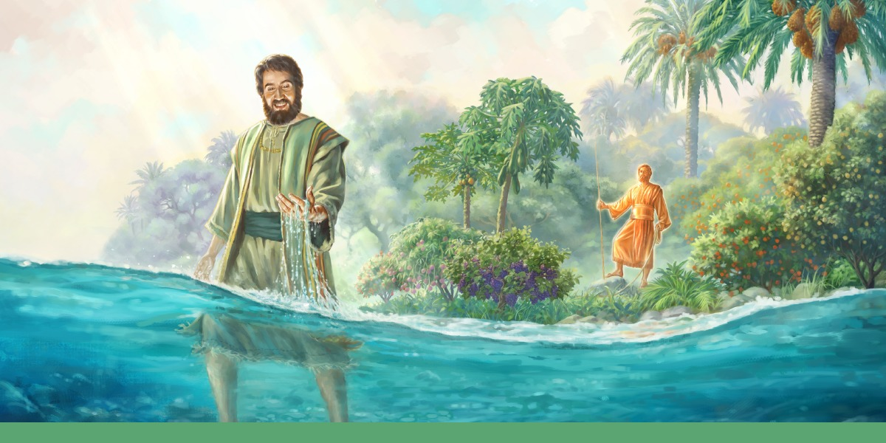

Slide 5
7 When I arrived there, I saw a great number of trees on each side of the river . . .
When it empties into the sea,
the salty water there becomes fresh.
9 Swarms of living creatures will live wherever the river flows . . .
12 Fruit trees of all kinds will grow on both banks of the river.

Slide 6
“Then the angel showed me the river
of the water of life, as clear as crystal,
flowing from the throne of God and of the Lamb 2 down the middle of the great street of the city.
On each side of the river stood the tree of life, bearing twelve crops of fruit, yielding its fruit every month. And the leaves of the tree are for the healing of the nations.”

Slide 7
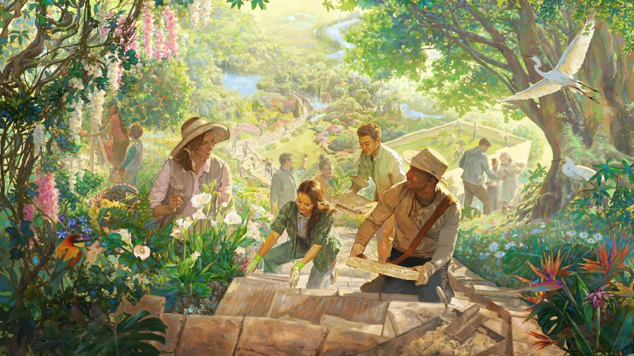

Slide 8
When it comes to the river of life
we confess that often we only like the water when it stays below our knees.

Slide 9
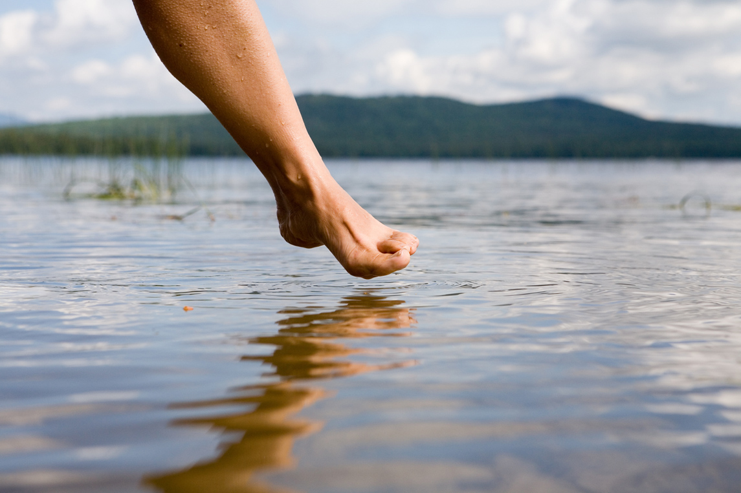

Slide 10
But we never can prove the delights of His love
Until all on the altar we lay;
For the favor He shows, for the joy He bestows,
Are for those who will trust and obey.

Slide 11
Ezekiel 48:35b
“And the name of the city from that time on will be:
the Lord is there.”

Slide 12
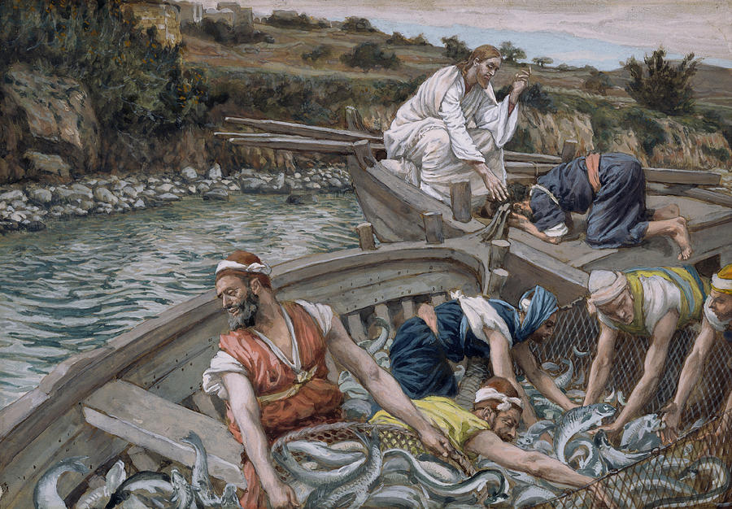

Slide 13
10 Fishermen will stand along the shore; from En Gedi to En Eglaim
there will be places for spreading nets.
The catch of ‘153 fish’ from John 21
matches the numerical value
of the places where this river flows.

Slide 14
Ezekiel 47 - “The water was coming down from under the south side of the temple, south of the altar.”
John 7:38 -
“Whoever believes in me, as Scripture has said, rivers of living water will flow from within them.”

Slide 15
‘. . . the river is rising
you can't hold it back no more
it's never gonna be the same
as it was before
ain't no use in fighting against the flow
it will take you where
you need to go . . .’
- The Blues Council

