Slide 2
Have you eaten from the tree that I commanded you not to eat from?”
12 The man said, “The woman you put here with me—she gave me some fruit from the tree, and I ate it.”
13 Then the Lord God said to the woman, “What is this you have done?”
The woman said, “The serpent deceived me, and I ate.”

Slide 3
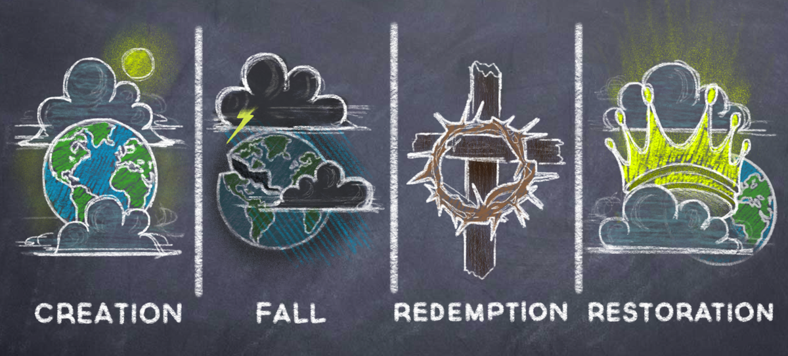

Slide 5
We believe that our good God . . . set out to find them,
though they, trembling all over, were fleeing from God.
And God comforted them,
promising to give them his Son,
born of a woman,
to crush the head of the serpent,
and to make them blessed.

Slide 7
20 Adam named his wife Eve, because she would become the mother of all the living.

Slide 8
We bristle in self-defense! That temptation happened to Adam and Eve, not me. It happened thousands of years ago. We protest like individualists. But the Bible teaches that the very fact we are able to think of ourselves as unrelated, disunited individuals presents evidence of our depravity.
- From Rev Andrew Kuyvenhoven

Slide 9
Romans 5:12 . . . just as sin entered the world through one man, and death through sin, and in this way death came to all people, because all sinned
Psalm 51:5 Surely I was sinful at birth, sinful from the time my mother conceived me.

Slide 10
Original Sin – This sin is called "original sin," (1) because it is derived from the original root of the human race; (2) because it is present in the life of every individual from the time of his birth, and therefore cannot be regarded as the result of imitation; and (3) because it is the inward root of all the actual sins that defile the life of man.
- Louis Berkhof, Systematic Theology

Slide 11
Total Depravity –
Not that each human being is as bad as could be, or that we are incapable of doing anything good, but that none of us is capable of any SAVING good.

Slide 12
Genesis 3:15 is called the Protevangelium (First Gospel)
15 And I will put enmity
between you and the woman,
and between your offspring and hers;
he will crush your head,
and you will strike his heel.”

Slide 13
21 The Lord God made garments of skin for Adam and his wife and clothed them.

Slide 14
Live in hope rather than despair:
1) Satan attacks what is beautiful and good

Slide 15
Live in hope rather than despair:
Satan attacks what is beautiful and good
Human limitations are not just at the edge of our abilities, but at the core of who we are

Slide 16
Live in hope rather than despair:
Satan attacks what is beautiful and good
Human limitations are not just at the edge of our abilities, but at the core of who we are
3) Redemption begins with enmity between God’s people and sin

Slide 17
Live in hope rather than despair:
Satan attacks what is beautiful and good
Human limitations are not just at the edge of our abilities, but at the core of who we are
3) Redemption begins with enmity between God’s people and sin
4) We are the ones who hide from God

