Slide 3
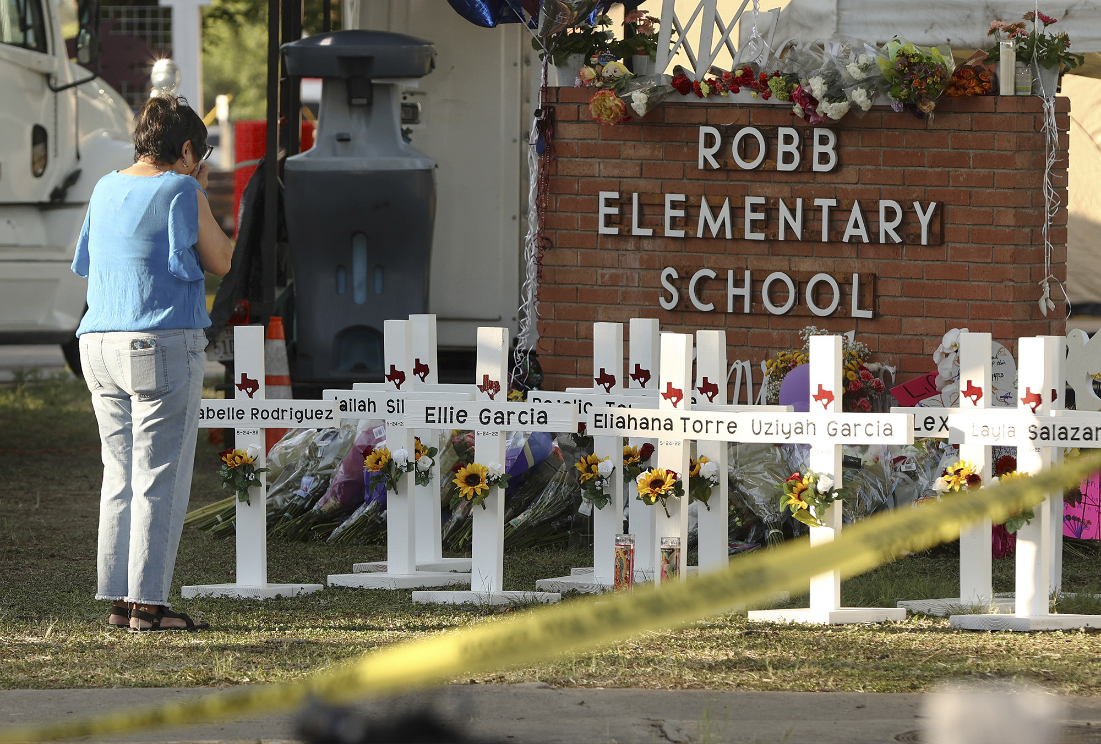

Slide 5
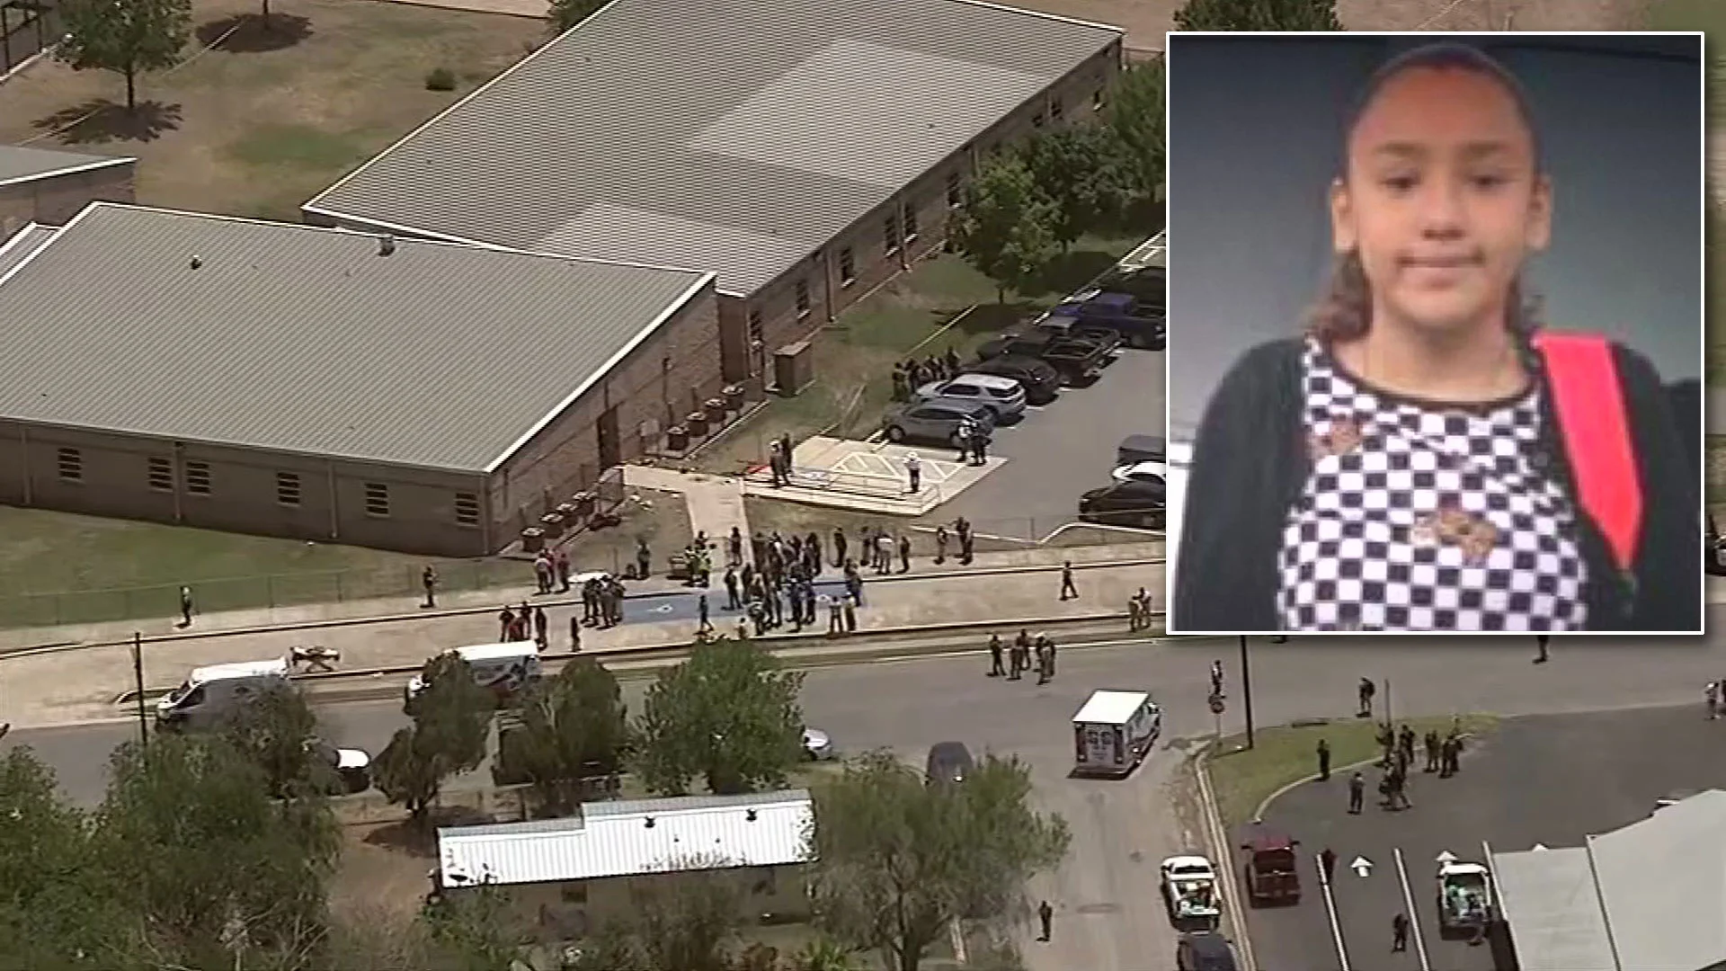

Slide 7
Matthew 1:21
She will give birth to a son, and you are to give him the name Jesus, [‘yeshua’] because he will save his people from their sins.”

Slide 8
How would you define salvation correctly?

Slide 9
Heidelberg Catechism answer 67:
‘our entire salvation rests on Christ’s one sacrifice for us on the cross.’
Q & A 29 –
Q. Why is the Son of God called “Jesus,”
meaning “savior”?
A. Because he saves us from our sins,
and because salvation should not be sought
and cannot be found in anyone else.

Slide 10
Receive the gift of salvation:
1) Start with praise for the gift of grace

Slide 11
From the Nicene Creed:
For us and for our salvation Jesus came down from heaven; he became incarnate by the Holy Spirit and the virgin Mary, and was made human.
He was crucified for us under Pontius Pilate; he suffered and was buried. The third day he rose again, according to the Scriptures. He ascended to heaven and is seated at the right hand of the Father.
He will come again with glory to judge the living and the dead. His kingdom will never end.

Slide 12
Receive the gift of salvation:
Start with praise for the gift of grace
Confess your sin to God for you cannot save yourself

Slide 13
Receive the gift of salvation:
Start with praise for the gift of grace
Confess your sin to God for you cannot save yourself
Receive the gift of salvation with trust

Slide 14
From Heidelberg Catechism answer 1:
‘. . . all things must work together for my salvation . . .’

Slide 15
Receive the gift of salvation:
Start with praise for the gift of grace
Confess your sin to God for you cannot save yourself
Receive the gift of salvation with trust
Rest in the order of salvation: ‘the golden chain of salvation’

Slide 16
Romans 8:29–30.
29 For those God foreknew he also predestined to be conformed to the image of his Son, that he might be the firstborn
among many brothers and sisters.
30 And those he predestined, he also called;
those he called, he also justified;
those he justified, he also glorified.

Slide 17
Receive the gift of salvation:
Start with praise for the gift of grace
Confess your sin to God for you cannot save yourself
Receive the gift of salvation with trust
Rest in the order of salvation: ‘the golden chain of salvation’
5) Put on the helmet of salvation with prayer

Slide 18
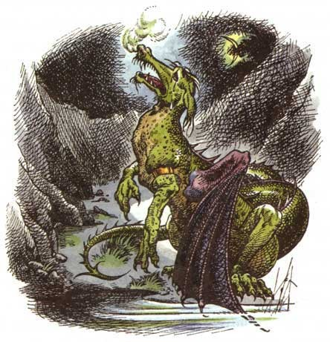

Slide 19
Receive the gift of salvation:
Start with praise for the gift of grace
Confess your sin to God for you cannot save yourself
Receive the gift of salvation with trust
Rest in the order of salvation: ‘the golden chain of salvation’
5) Put on the helmet of salvation with prayer
6) Participate in the showing and sharing of salvation

Slide 20
Receive the gift of salvation:
Start with praise for the gift of grace
Confess your sin to God for you cannot save yourself
Receive the gift of salvation with trust
Rest in the order of salvation: ‘the golden chain of salvation’
5) Put on the helmet of salvation with prayer
6) Participate in the showing and sharing of salvation
7) Train to be fit for heaven

