Slide 2
When he was alone, the Twelve and the others around him asked him about the parables. 11 He told them, “The secret of the kingdom of God has been given to you . . .”

Slide 3
20 - like seed sown on good soil, [they] hear the word, accept it, and produce a crop—some thirty, some sixty, some a hundred times what was sown.”

Slide 4
Though when the sower sowed
The winged fowls took part,
part fell in thorn and never turned to corn
part found no root upon the flinty road –Christ at all hazards fruit hath shewed . . .
GM Hopkins

Slide 6
Made in God’s image
to live in loving communion with our Maker,
we are appointed earthkeepers and caretakers to tend the earth, enjoy it,
and love our neighbors.
God uses our skills
for the unfolding and well-being of his world
so that creation and all who live in it may flourish.

Slide 7
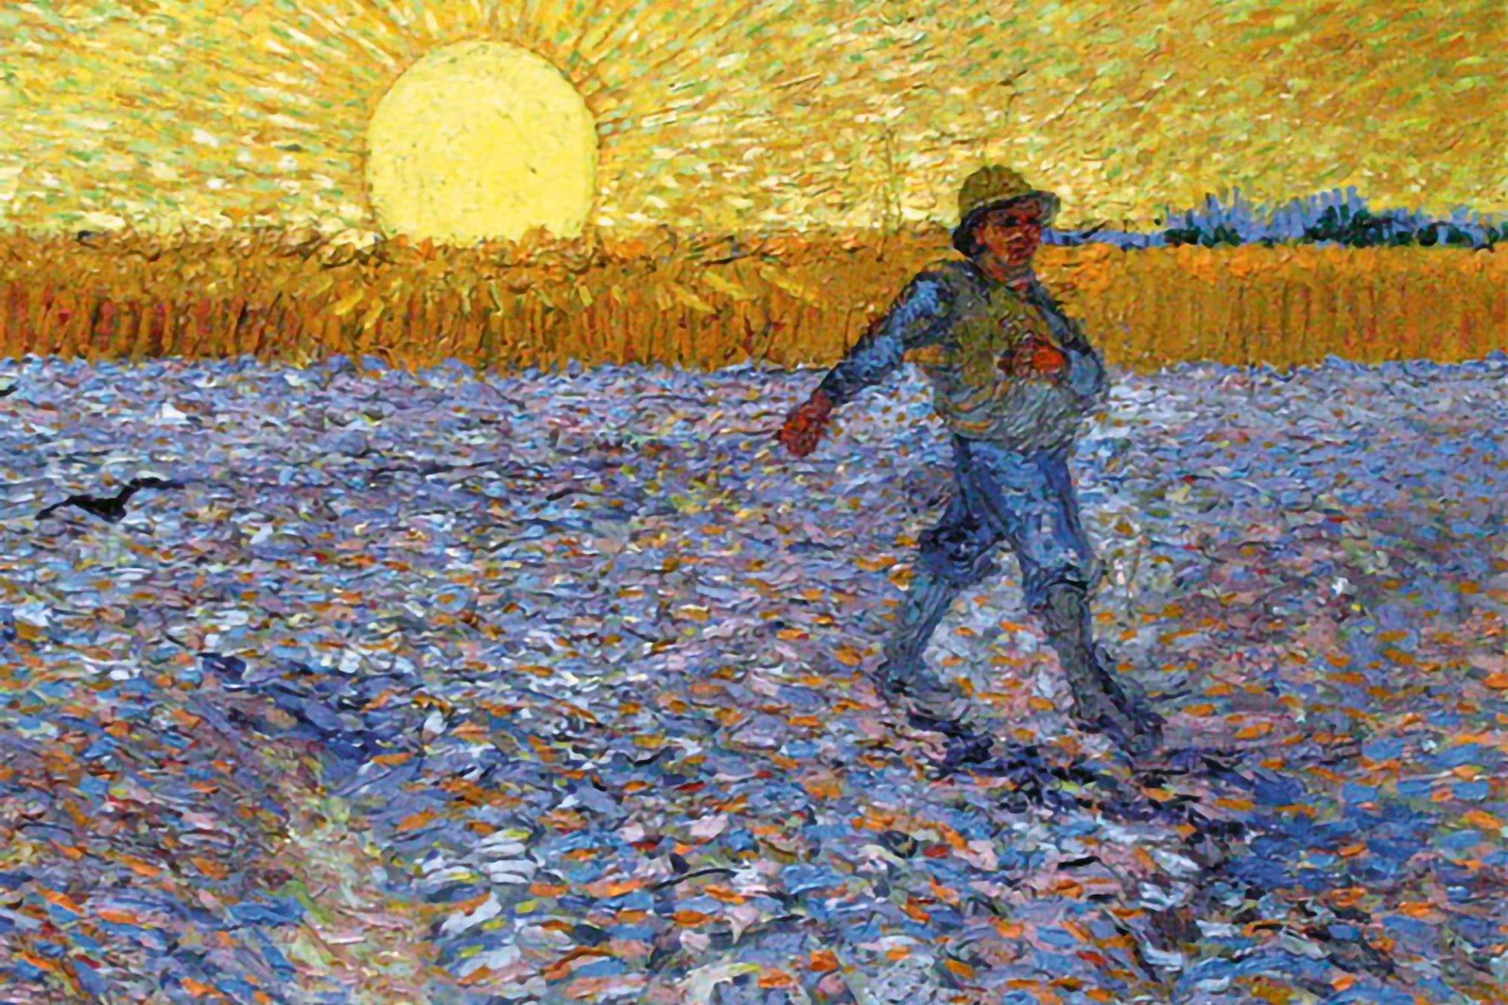
The Kingdom of God:
is catholic, not parochial

Slide 8
“There is not a square inch in the whole domain of our human existence
over which Christ, who is Sovereign over all, does not cry, Mine!”
- Abraham Kuyper

Slide 9
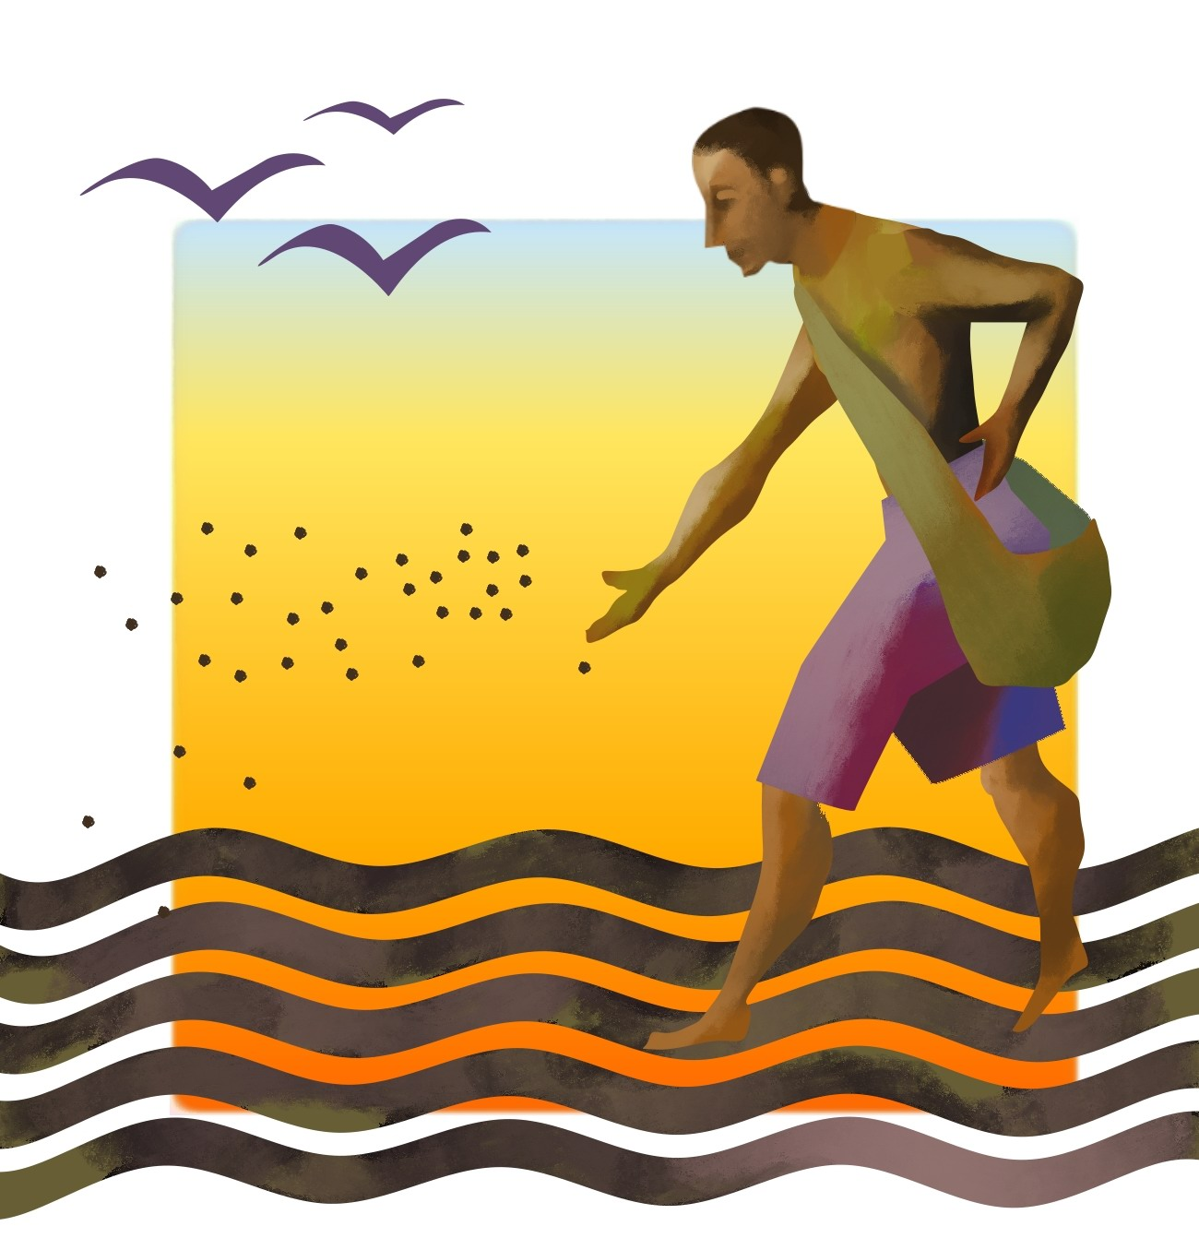
The Kingdom of God:
is catholic, not parochial
is a mystery and not manipulated by human means

Slide 10
The Kingdom of God:
is catholic, not parochial
is a mystery and not manipulated by human means
It came up, grew and produced a crop, some multiplying thirty, some sixty, some a hundred times.

Slide 11
The Kingdom of God:
is catholic, not parochial
is a mystery and not manipulated by human means
Kingdom mysteries – to believe we win by losing our very selves! To believe that love is everything! To believe that power is great danger, wealth slavery, comfortable life a misfortune! It is not easy.

Slide 12
The Kingdom of God:
is catholic, not parochial
is a mystery and not manipulated by human means
Whether we like it or not, asking is the rule of the Kingdom.
- Charles Spurgeon

Slide 13
The Kingdom of God:
is catholic, not parochial
is a mystery and not manipulated by human means
is actually present, not virtually present

Slide 14
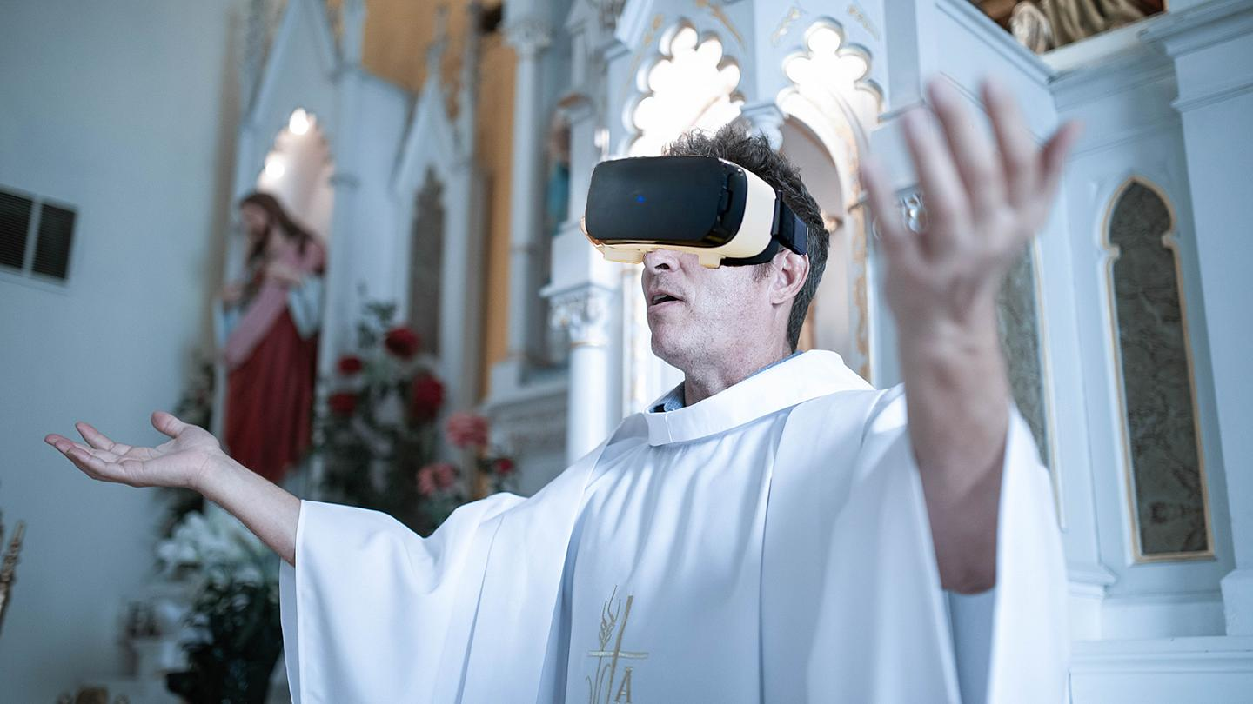

Slide 15
“God really meant it when He said,
'Seek FIRST the kingdom of God.'”
“The restoration in Christ of creation and the coming of the kingdom of God are one and the same.”

Slide 16
“God’s sovereign rule extends over all of our lives. All of the cultural spheres
are before the face of God.”
- Abraham Kuyper

Slide 17
The Kingdom of God:
is catholic, not parochial
is a mystery and not manipulated by human means
is actually present, not virtually present
demands a response

Slide 18
Mark 1:15 - The time has come,” he said. “The kingdom of God has come near. Repent and believe the good news!”

Slide 19
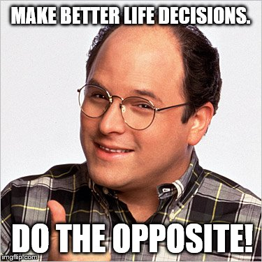

Slide 21
Matthew 18:3:
“I tell you the truth, unless you change
and become like little children,
you will never enter the kingdom of heaven.”

