Slide 2
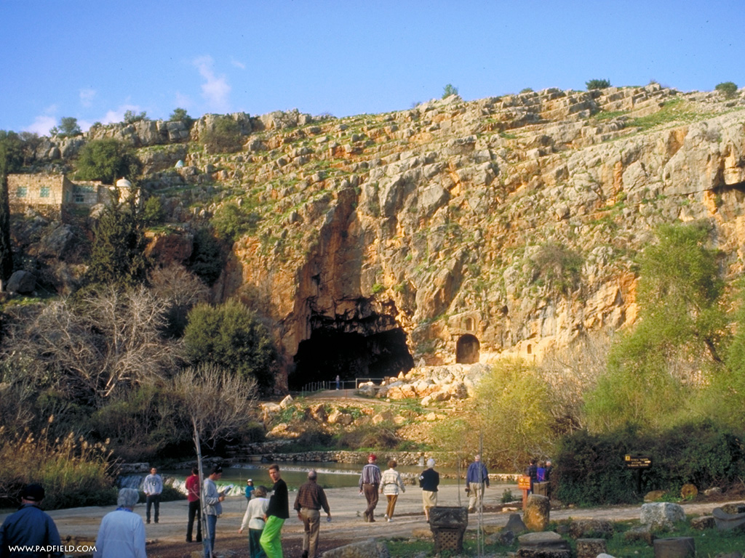

Slide 3
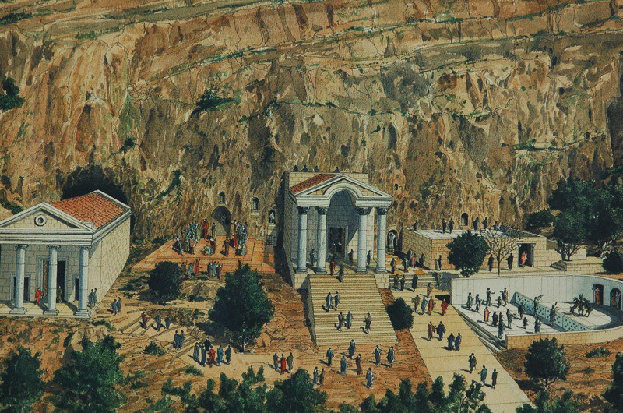

Slide 4
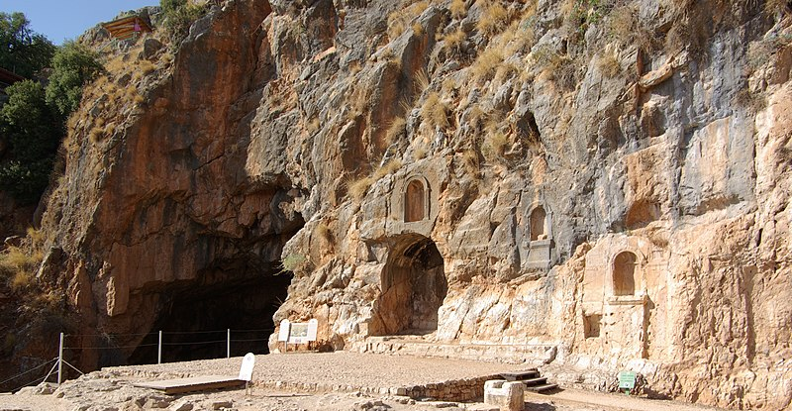

Slide 5
18 And I tell you that you are Peter and on this rock I will build my church, and the gates of Hades will not overcome it. 19 I will give you the keys of the kingdom of heaven; whatever you bind on earth will be bound in heaven, and whatever you loose on earth will be loosed in heaven.”

Slide 6
Don’t stay away from church.
Don’t just go to church.
BE church.

Slide 7
Who do YOU say I am?

Slide 8
If I desire my relationships to be real,
purposeful, fulfilling, loving, it starts with my relationship Jesus as the true God come to give me his life.
Be real with God.
Then we can begin to be real with others.

Slide 9
Reformed Christians have a high view of the church, and of committing to being church.
Belgic Confession:
“. . . There is no salvation apart from it [the church] . . .”

Slide 10
“Love cannot exist in isolation:
away from others, love bloats into pride.
Grace cannot be received privately:
cut off from others, it is perverted into greed.
Hope cannot develop in solitude:
separated from the community,
it goes to seed in the form of fantasies.
No gift, no virtue can develop and remain healthy apart from the community of faith.”

Slide 11
Being a committed and active participation in the local church purifies us of one temptation and one misconception.
The temptation is to ‘self-sufficiency.’
The misconception is called an ‘excarnation’ faith.

Slide 12
James 2 -
15 Suppose a brother or a sister is without clothes and daily food. 16 If one of you says to them, “Go in peace; keep warm and well fed,” but does nothing about their physical needs, what good is it?
17 In the same way, faith by itself,
if it is not accompanied by action, is dead.

Slide 13
In The Screwtape Letters, CS Lewis describes both the need to confess, and
the temptation to judgment, regarding our experiences with one another in church.

Slide 14
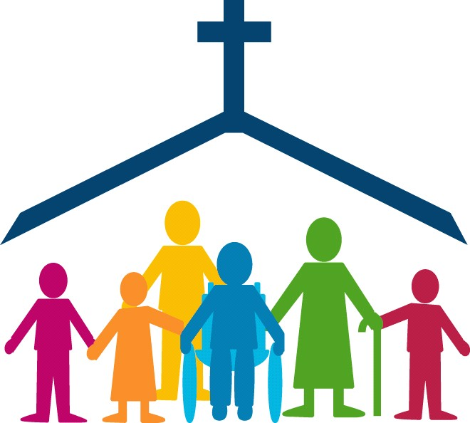

Slide 15
‘. . . the way to save the world is not through more rules to live by,
but through right relationships to live for.’

Slide 16
‘A new command I give you:
Love one another.
As I have loved you, so you must love one another.’

