Slide 2
I say, ‘My purpose will stand,
and I will do all that I please.’
What I have said, that I will bring about;
what I have planned, that I will do.
13 I am bringing my righteousness near, it is not far away;
and my salvation will not be delayed.

Slide 3
3 “Listen to me, you descendants of Jacob . . .”
8 “Remember this, keep it in mind,
take it to heart, you rebels.”
12 “Listen to me, you stubborn-hearted, you who are now far from my righteousness.”

Slide 4
But the first problem in trusting that God is sovereign is NOT how bad things are in the world or in your life,
but what is misshapen and malformed inside of us.

Slide 5
What does it mean that God is sovereign?
God has the rightful authority, the freedom, the wisdom, and the power to bring about everything that he intends to happen.
Is 46 - ‘I am God, and there is no other;
I am God, and there is none like me.
I say, ‘My purpose will stand,
and I will do all that I please.’
What I have said, that I will bring about;
what I have planned, that I will do.’

Slide 6
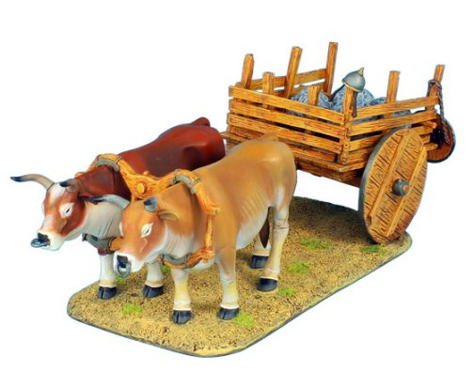

Slide 7
vs 4 - I am he, I am he who will sustain you. I have made you and I will carry you; I will sustain you and I will rescue you.

Slide 8
1st, God is still God
2nd, Jesus is the ultimate experience
of God’s sovereignty on earth
3rd, God’s authority is for our good,
we call this common grace
4th, so assured, we can bring a non-anxious presence into the sacrifices and sufferings of the kingdom.

Slide 9
1st, God is still God
Heidelberg Catechism Q & A 27
Q. What do you understand by the providence of God?
. . . all things, come to us not by chance
but by his fatherly hand.

Slide 10
1st, God is still God
2nd, Jesus is the ultimate experience
of God’s sovereignty on earth
“God has, in Jesus Christ, made our history, God’s!”

Slide 11
1st, God is still God
2nd, Jesus is the ultimate experience
of God’s sovereignty on earth
3rd, God’s authority is for our good,
we call this common grace

Slide 12
Common grace accounts for the good all around us in life and creation
that is shared by all creatures and human beings, whether good or bad, saved or sinner, elect or reprobate.
God’s common grace is a way to say
God desires also our earthly good.
“He shines in all that’s fair”

Slide 13
1st, God is still God
2nd, Jesus is the ultimate experience
of God’s sovereignty on earth
3rd, God’s authority is for our good,
we call this common grace
4th, so assured, we can bring a non-anxious presence into the sacrifices and sufferings of the kingdom.

Slide 14
We can be patient when things go against us, thankful when things go well, and for the future we can have
good confidence in our faithful God and Father that nothing in creation will separate us from his love.
For all creatures are so completely in God’s hand . . .

