Slide 2
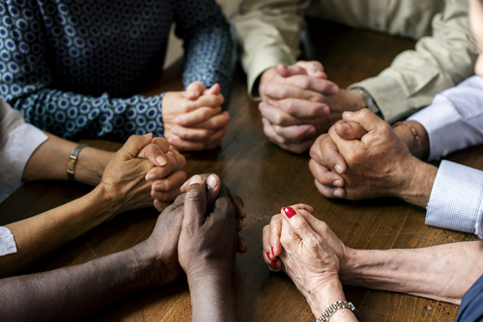

Slide 3
Bible verses about communal conversion or repentance:
Nehemiah 9:2
Daniel 9
Matthew 11:20-21
Revelation 2

Slide 4
Christian conversion is more than
sorrow for sin and hope for forgiveness.
It’s also a school of discipleship and cross-bearing . . . we learn to take leave of the old way, and we train and are equipped daily in living as citizens of the new world.
We belong to Jesus and live in God’s kingdom, we must re-order our lives. Not only individually, but also in our covenanted belonging
together.

Slide 5
2 Chronicles 7:13-14
13 “When I shut up the heavens so that there is no rain, or command locusts to devour the land or send a plague among my people, 14 if my people, who are called by my name, will humble themselves and pray and seek my face and turn from their wicked ways, then I will hear from heaven, and I will forgive their sin and will heal their land.

Slide 6
Psalm 81:11-12, ESV reveals,
“But my people did not listen to my voice; Israel would not submit to me. So I gave them over to their stubborn hearts, to follow their own counsels.”

Slide 7
Christian Reformed Church statement –
There’s room for personal responsibility,
but not at the expense of understanding
how we affect and are affected by the community. It’s a both / and.
Both personal and communal responsibility
are important to God and should be to us.

Slide 8
Revelation 2 –
2 “To the angel of the church in Ephesus write:
4 Yet I hold this against you: You have forsaken the love you had at first. 5 Consider how far you have fallen! Repent and do the things you did at first.

Slide 9
CRCNA statements: We recognize that we have remained silent about racial injustice and unjust actions in our nations all too frequently. Our silence on issues of race has been heard more clearly than our calls for reconciliation with God . . . We lament this sin, and encourage congregations to join us in committing to continue our learning about racism and its effects in our lives and
societal structures.

Slide 10
2020 Human Sexuality Report:
Despite repeated and strong exhortations of past study committee reports to love and care for brothers and sisters who are attracted to the same sex as equal members of the body of Christ, the church has all-too-often ostracized, shunned, or ignored such Jesus-followers.

Slide 11
We lament that our abuse of creation has brought lasting damage to the world we have been given: polluting streams and soil,
poisoning the air, altering the climate, and damaging the earth.
We commit ourselves to honor all God’s creatures and to protect them from abuse and extinction, for our world belongs to God.
- Our World Belongs to God, 51

Slide 13
Every good thing is good for us
only when it’s pursued in the right way
and not the wrong way.
Repentance helps re-align and re-form our pursuits.
- Jay Budziszewksi

Slide 14
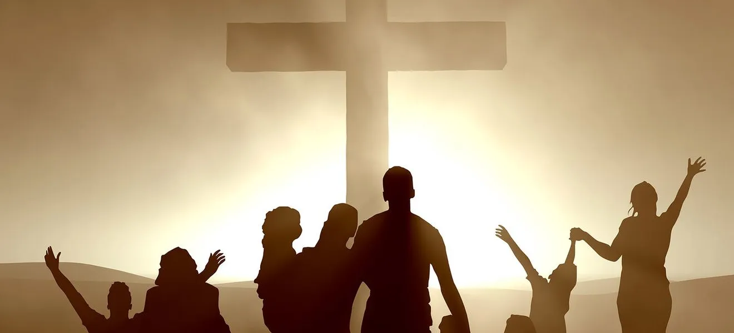

Slide 15
14 if my people, who are called by my name, will humble themselves and pray and seek my face and turn from their wicked ways, then I will hear from heaven, and I will forgive their sin and will heal their land.

Slide 16
1 Peter 1:18-19 -
“You were redeemed from the empty way of life handed down to you from your ancestors,”

Slide 17
Psalm 106
We have sinned, even as our ancestors did . . .
. . . Save us, Lord our God . . .

