Slide 2
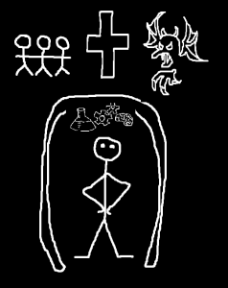

Slide 3
Lord, our Lord,
how majestic is your name in all the earth!
You have set your glory
in the heavens.

Slide 4
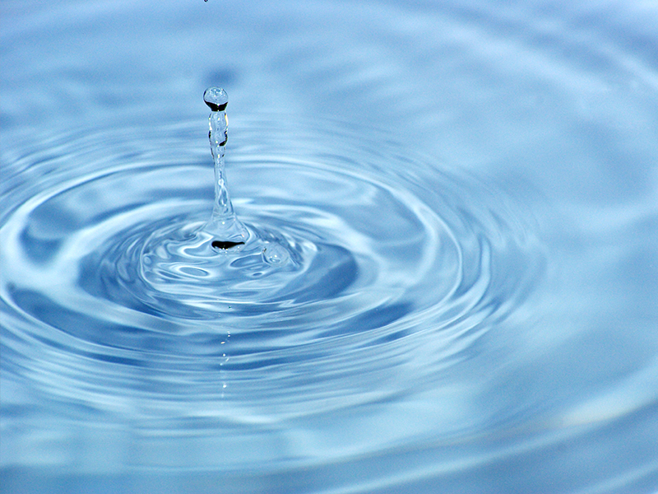

Slide 5
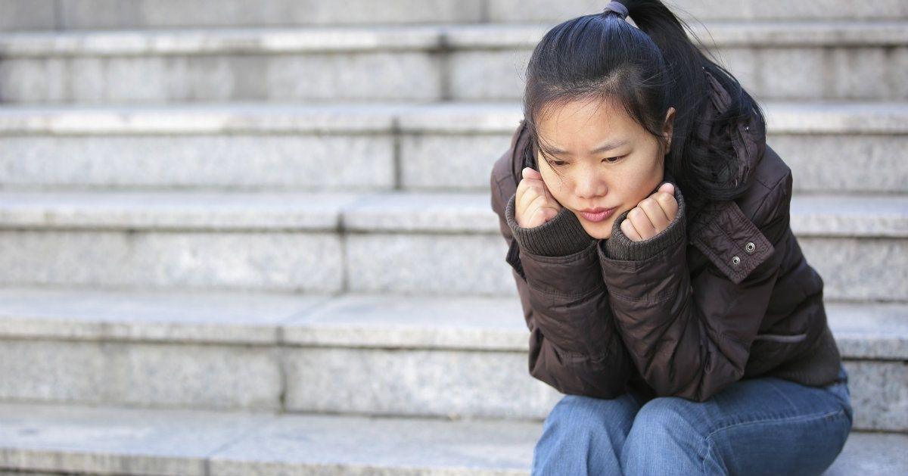
Would I spend forever here
and not be satisfied
– Sarah McLachlan, Possession

Slide 6
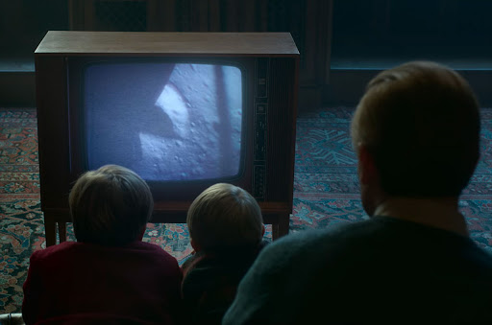

Slide 7
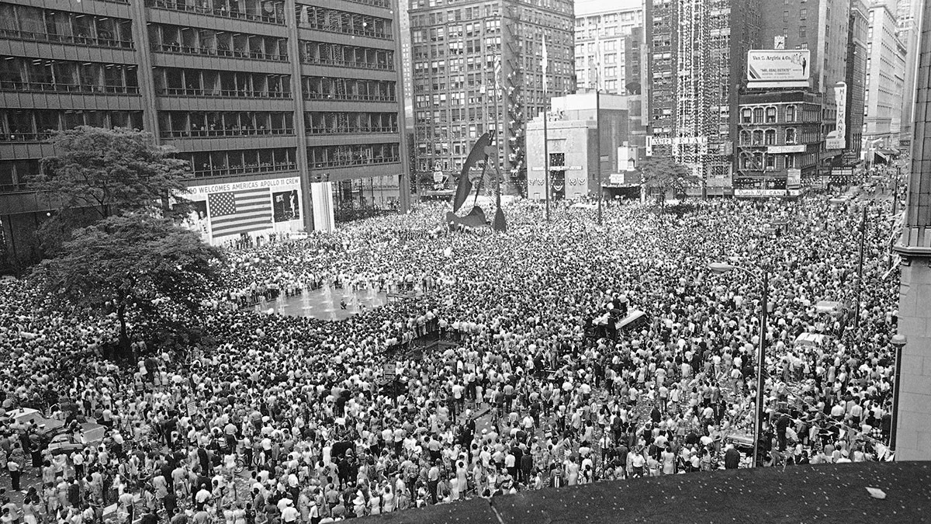

Slide 8
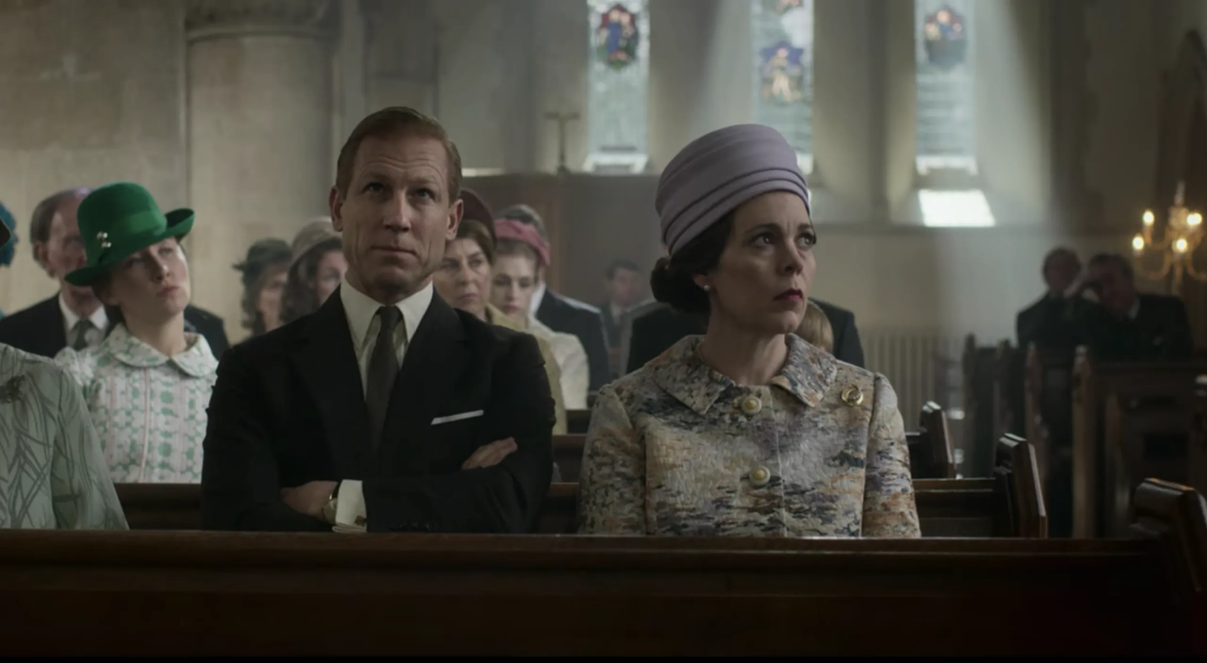

Slide 9
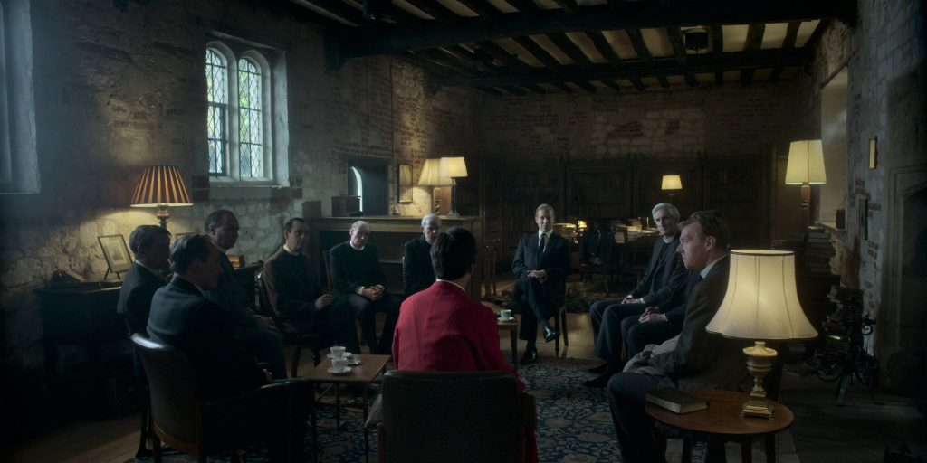

Slide 10
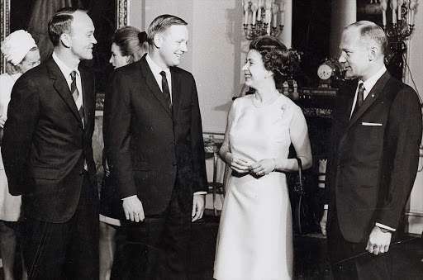

Slide 12
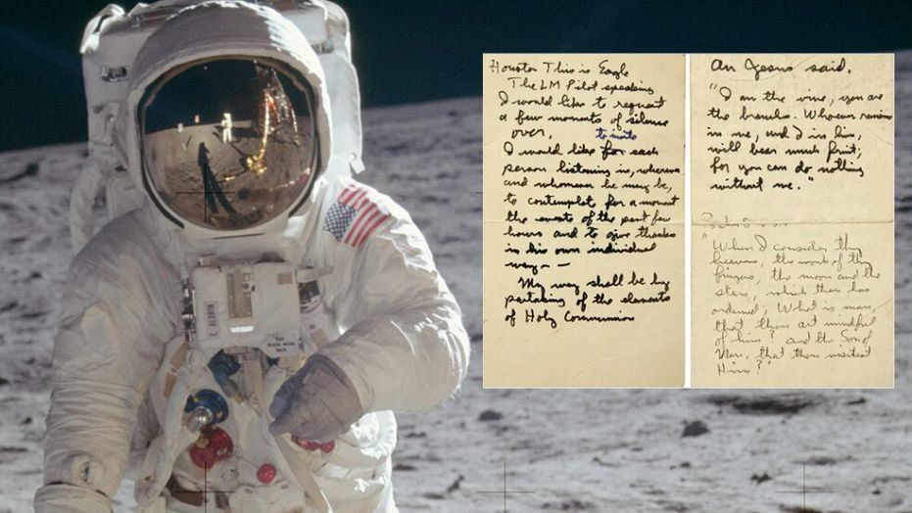

Slide 13
3 “When I look at your heavens, the work of your fingers, the moon and the stars that you have established;
4 "What are human beings that you are mindful of them, human beings that you care for them?”

Slide 14
4 "What are human beings that you are mindful of them, human beings that you care for them?”
5 You have made them a little lower than the angels
and crowned them with glory and honor.

Slide 15
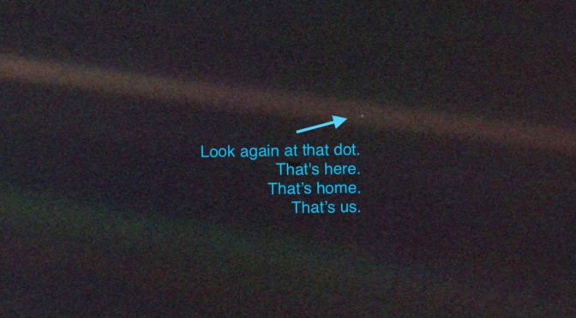

Slide 16
4 "What are human beings that you are mindful of them, human beings that you care for them?”
5 You have made them a little lower than the angels
and crowned them with glory and honor.

Slide 17
6 You made them rulers over the works of your hands;
you put everything under their feet:

