Slide 2
Do I feel powerful?

Slide 3
For the message of the cross is foolishness to those who are perishing, but to us who are being saved it is the power of God.

Slide 4
For the foolishness of God is wiser
than human wisdom, and the weakness of God is stronger than human strength.

Slide 5
But God chose the foolish things of the world to shame the wise;
God chose the weak things of the world to shame the strong.
God chose the lowly things of this world and the despised things—and the things that are not—to nullify the things that are . . .

Slide 6
If you base your responses
on the cross of Jesus,
and take up your cross and follow him,
what looks like weakness
is, in grace, the power of God.

Slide 7
Consider how these offerings are really powerful to change life for the better:
Forgiveness
Generosity
Hospitality
Justice

Slide 8
FORTITUDE –
First, it means courage, bravery, valor, heroism . . .
The second meaning is endurance, tenacity, perseverance.

Slide 9
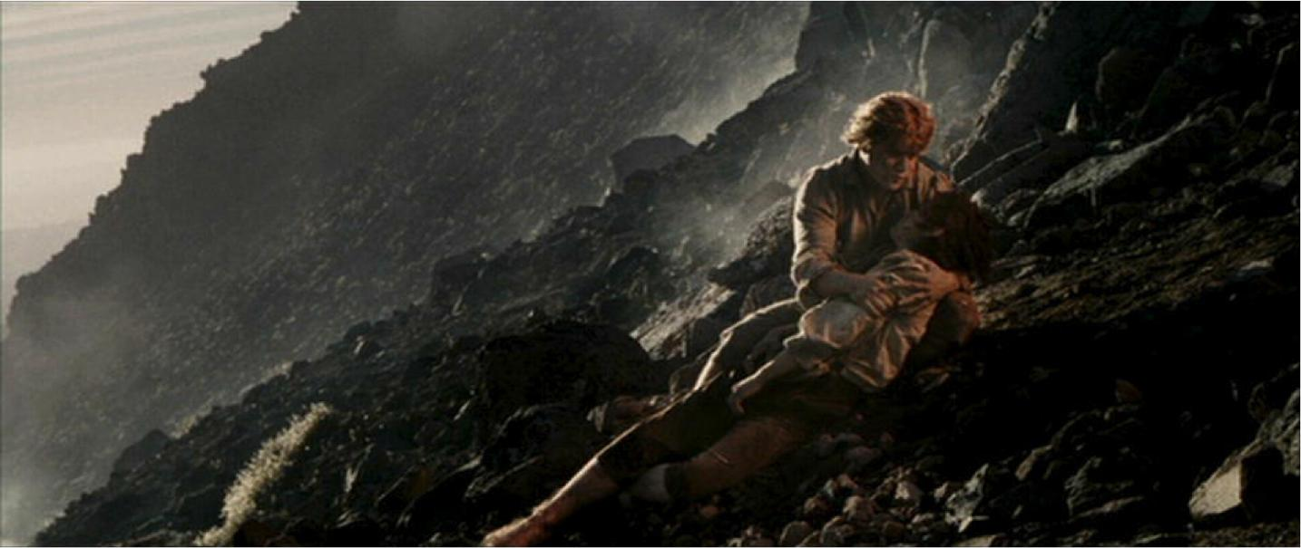

Slide 10
"What do I value the most?"
"What do I fear losing the most?"

Slide 11
Do a great thing
for the Kingdom of God.

Slide 12
‘Lord, give me strength!’

